Slide 1
Uber Supply and Demand Gap Analysis
CASE STUDY
By:
Nitish Ram

Slide 2
AIM:
Uber Supply and Demand Gap Analysis

Slide 3
INTRODUCTION:
Analysing and visualizing the Supply and Demand. The Uber dataset is downloaded from kaggle. We will use POWER BI for data visualization & for data analysis.

Slide 4
PROBLEM STSTEMENT:
Analysis preparation
What is total requests by status
What is total requests by pickup point
What is the Demand by date
Count of Requests and Drivers

Slide 5
METHODOLOGY:
Analysing and visualizing the Supply and Demand. The Uber dataset is downloaded from kaggle. We will use POWER BI for data visualization & for data analysis.
Data collecting method:
We imported the data into POWER BI.
Removed NULL values.

Slide 6
Columns in dataset:
Request id
Pickup point
Driver id
Status
Request timestamp
Drop timestamp

Slide 7
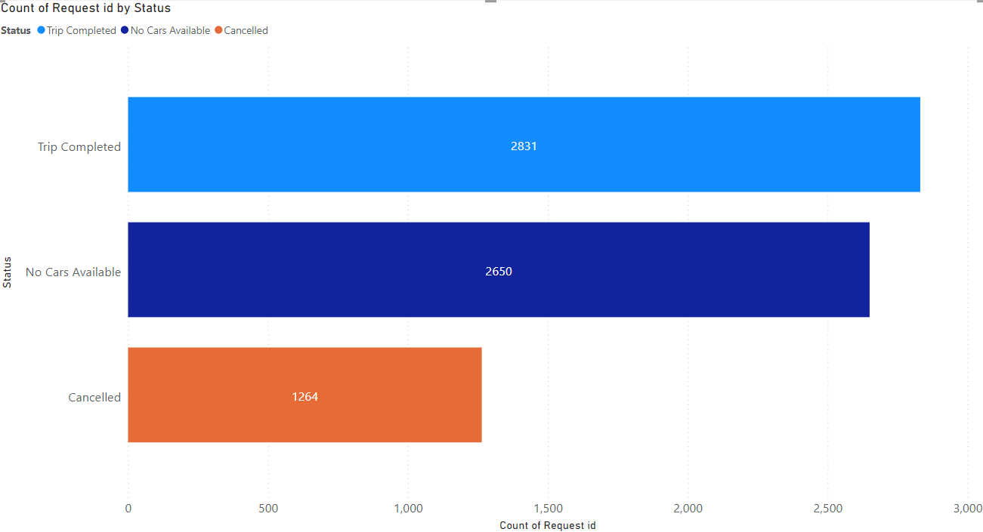
ANALYSIS:
What is total requests by status
Trip Completed had the highest Count of Request id at 2,831, followed by No Cars Available at 2,650 and Cancelled at 1,264.

Slide 8
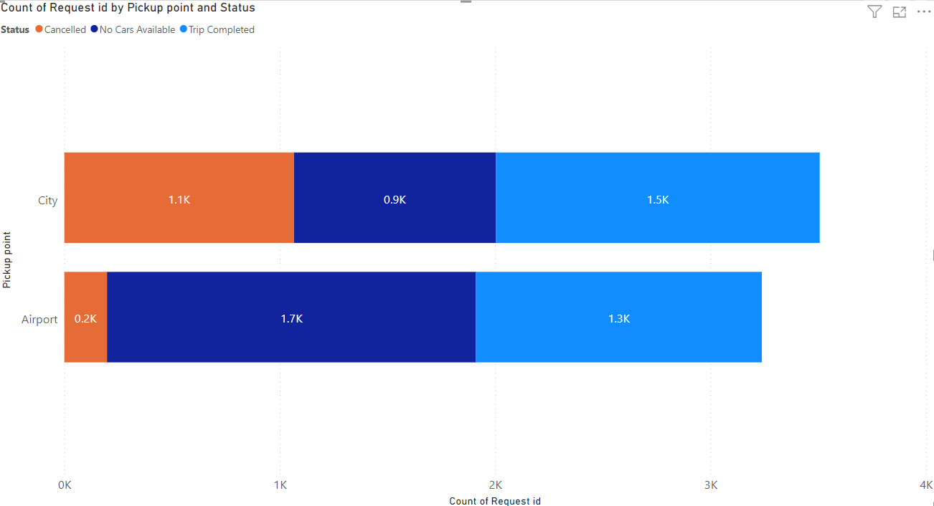
What is total requests by pickup point
Trip Completed had the highest average Count of Request id at 1,415.50, followed by No Cars Available at 1325 and Cancelled at 632.

Slide 9
What is the Demand by date
Drop time
Year | Month | Day | Status | Count of Request id
 |  |  | Cancelled | 1264
 |  |  | No Cars Available | 2650
2016 | July | 11 | Trip Completed | 582
2016 | July | 12 | Trip Completed | 568
2016 | July | 13 | Trip Completed | 569
2016 | July | 14 | Trip Completed | 536
2016 | July | 15 | Trip Completed | 546
2016 | July | 16 | Trip Completed | 30

Slide 10
Request time
Year | Month | Day | Status | Count of Request id
2016 | July | 11 | Cancelled | 262
2016 | July | 11 | No Cars Available | 504
2016 | July | 11 | Trip Completed | 601
2016 | July | 12 | Cancelled | 240
2016 | July | 12 | No Cars Available | 505
2016 | July | 12 | Trip Completed | 562
2016 | July | 13 | Cancelled | 270
2016 | July | 13 | No Cars Available | 490
2016 | July | 13 | Trip Completed | 577
2016 | July | 14 | Cancelled | 252
2016 | July | 14 | No Cars Available | 571
2016 | July | 14 | Trip Completed | 530
2016 | July | 15 | Cancelled | 240
2016 | July | 15 | No Cars Available | 580
2016 | July | 15 | Trip Completed | 561

Slide 11
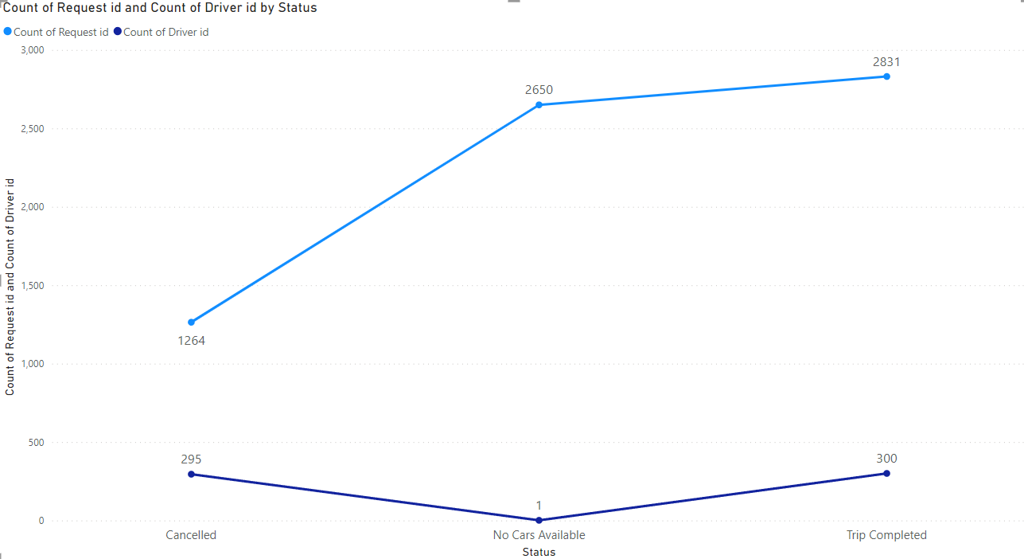
Count of Requests and Drivers
No Cars Available had 2,650 Count of Request id and 1 Count of Driver id. Trip Completed had 2,831 Count of Request id and 300 Count of Driver id. Cancelled had 1,264 Count of Request id and 295 Count of Driver id.

Slide 12
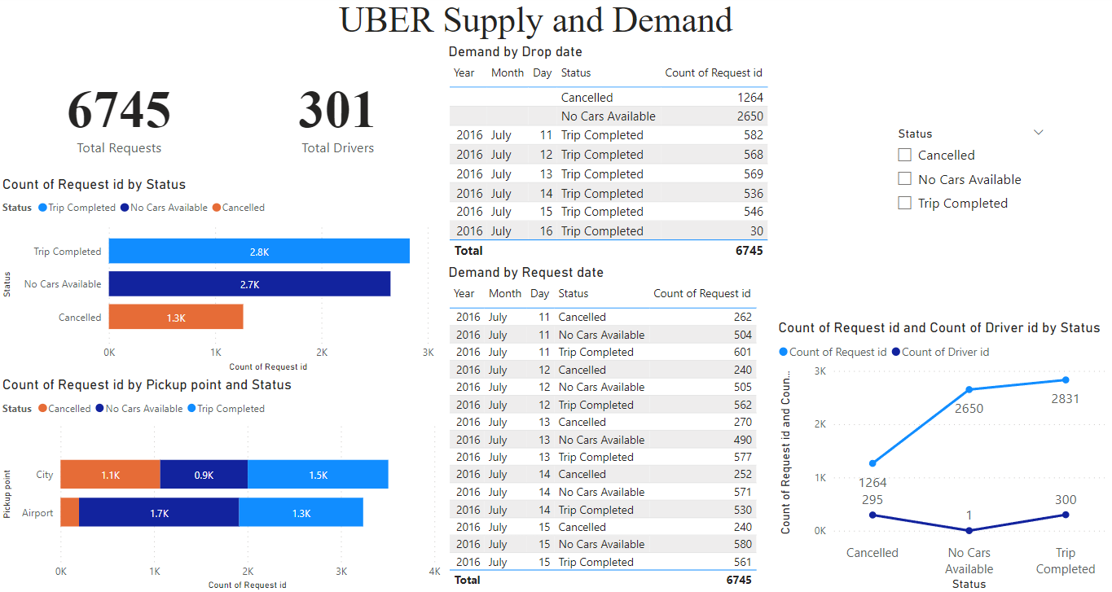

Slide 13
INSIGHTS:
Request id, Pickup point, Driver id, Status, Request timestamp, Drop timestamp are mainly used for the analyse the dataset.

Slide 14
CONCLUSION:
Trip Completed had the highest Count of Request id at 2,831, followed by No Cars Available at 2,650 and Cancelled at 1,264.
Trip Completed had the highest average Count of Request id at 1,415.50, followed by No Cars Available at 1325 and Cancelled at 632.
No Cars Available had 2,650 Count of Request id and 1 Count of Driver id. Trip Completed had 2,831 Count of Request id and 300 Count of Driver id. Cancelled had 1,264 Count of Request id and 295 Count of Driver id.

